Slide 1

First Encounter with C++
Note: Please turn off your microphone and camera
Mr. Gao’s Algorithm
Competition Training Camp

Slide 2
Overview
Machine language, binary, programming language
Compilation vs interpretation
Integrated development environment IDE
Source program, source code, code, writing code, ‘punching’ code

Slide 3
Program Structure
1 // Example : Hello World
2 #include <bits/stdc++.h>
3 using namespace std;
4 int main(){
5 cout<< "Hello, World!";
6 return 0;
7 }
“#include” is followed by the header file, no semicolon is needed at the end of the line
Universal header file “bits/stdc++.h”: Just include this header file, add angle brackets at both ends
“using namespace” is followed by the namespace, ending with a semicolon.
The “main()” function is the main part of the program
The function content is enclosed between a pair of curly braces
Inside the main() function, each statement must end with a semicolon;
The last statement returns 0;
“cout” is used to output content to the console. Contents between double quotes will be output as is.
Lines beginning with “//” are comments, written for humans
to read, and will be ignored by computers.
Line 2, 3, 4, 6 and 7 are fixed content, must be present in each program
Line 1 is a comment, optional
Line 5 is the specific program content, each program is different

Slide 4
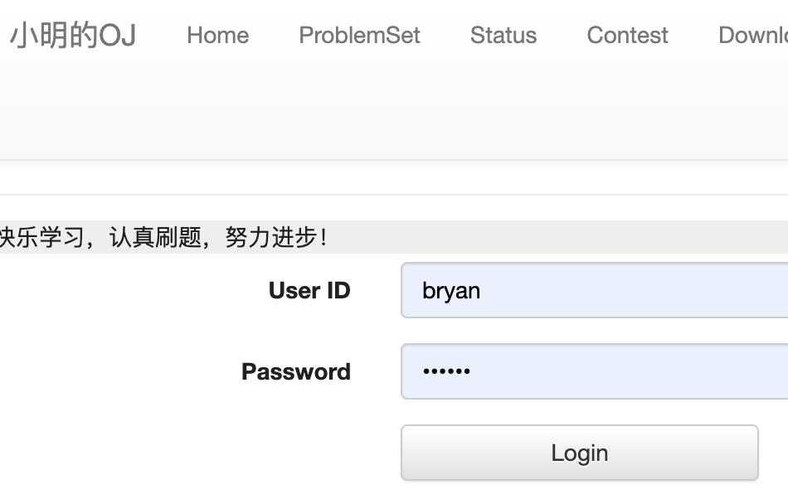
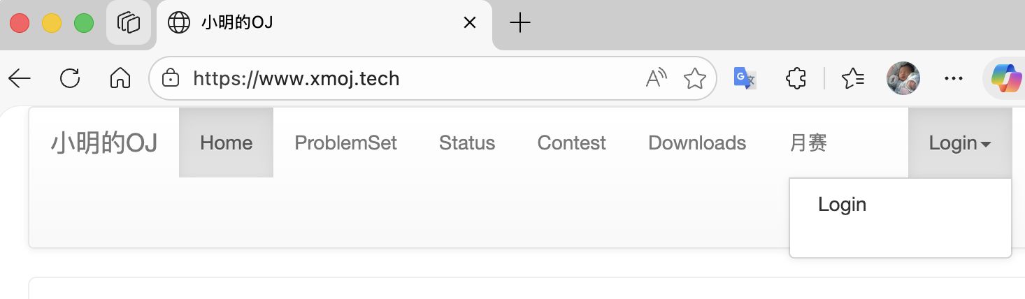
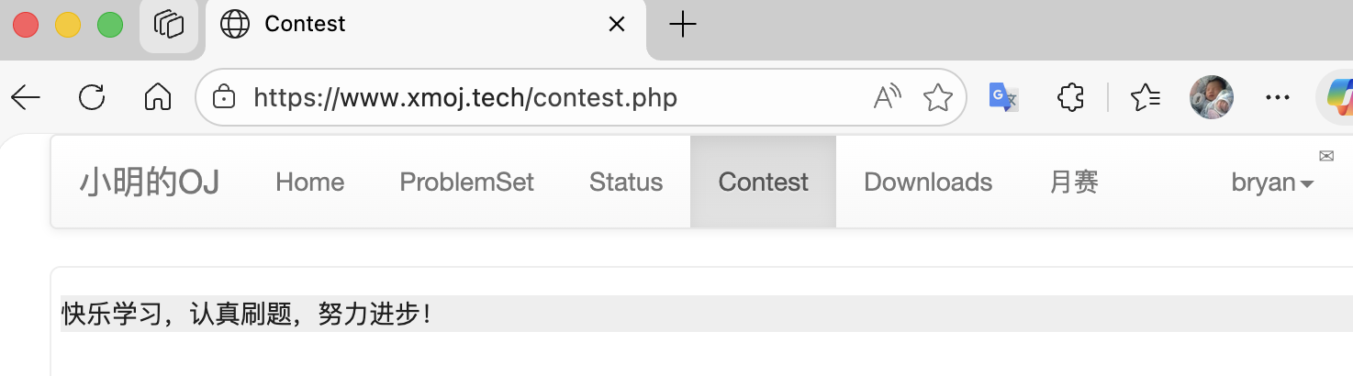
Training Site
Online practice system:
http://xmoj.tech
①
②
③

Slide 5
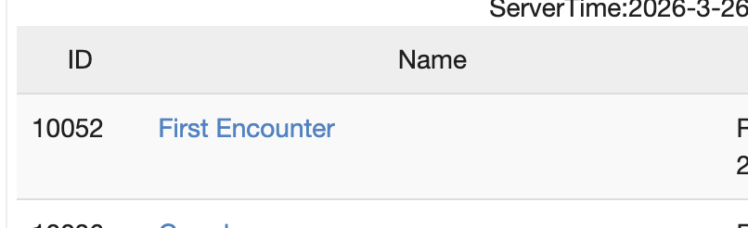
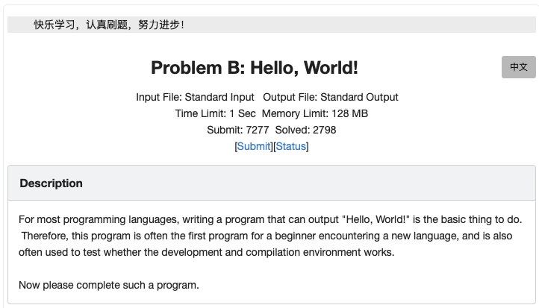
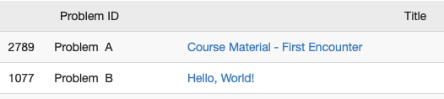
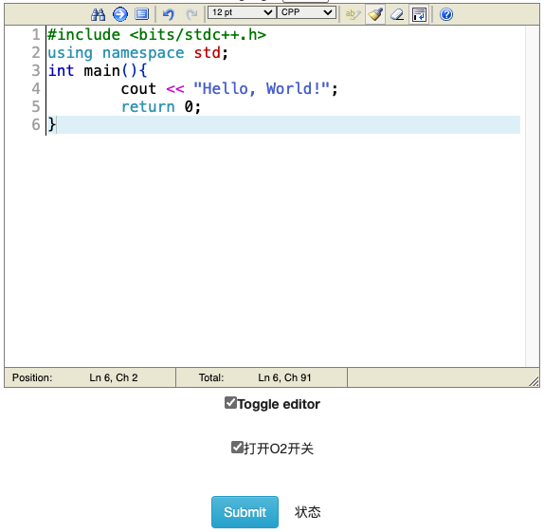
Training Site
①
③
②
Paste code here
④

Slide 6
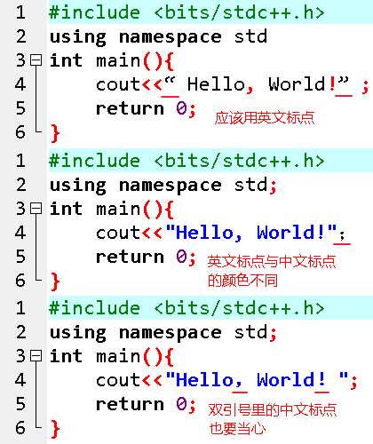
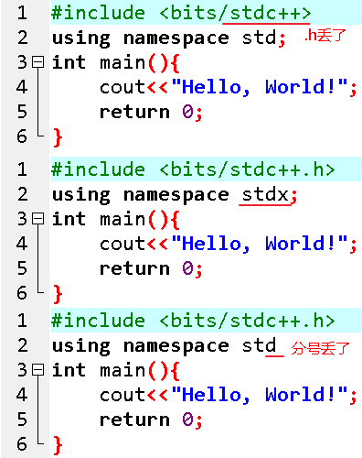
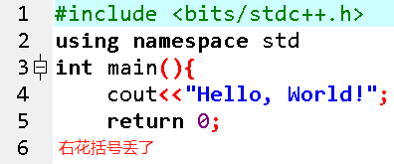
Common Mistakes
Missed .h
Use correct punctuation
Missed right curly bracket
Incorrect punctuation have different colour
Missed ;
Punctuation between quotation marks.

Slide 7
Operators and Expressions
Integer operations
+(addition), -(subtraction), *(multiplication), /(division), % (modulo operation)
The quotient obtained by division is an integer with no decimal part (instead of rounding, the decimal part is discarded)
Operations of real numbers:
+ (addition), - (subtraction), * (multiplication), / (division)
No modulo operation
The quotient obtained by division includes the decimal part
Code | Console output
cout <<6+7; | 13
cout <<15-3; | 12
cout <<10/3; | 3
cout <<11/3; | 3
cout <<11%3; | 2
Code | Console output
cout << 6.5+7.6; | 14.1
cout << 15.7-3.3*2.5; | 7.45
cout << 11.45/3.2; | 3.578125
cout << 11.45%3.2; | error
Multiplication and division are written differently compared to mathematical operators
The multiplication operator cannot be omitted
Just write the expression directly to get the answer
The order of operations: From left to right, multiplication, division and modulo first, then addition and subtraction. Parentheses take precedence over all others.
Code | Console output
cout <<6+7+8%3-8/3; | 13
cout <<15-3*2; | 9
cout <<(15-3)*2; | 24
cout <<(5-2)*(5+2)/4; | 5

Slide 8
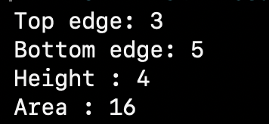
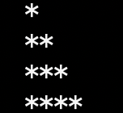

Output: cout Statement
// Example : area of a trapezoid
#include <bits/stdc++.h>
using namespace std;
int main(){
cout<< "Top edge: " << 3 << endl;
cout<< "Bottom edge: " << 5 << endl;
cout<< "Height: " << 4 << endl;
cout<< "Area: " << (3+5)*4/2 << endl;
return 0;
}
Console window :
// Example : Output character triangle
#include <bits/stdc++.h>
using namespace std;
int main(){
cout<< " * " << endl;
cout<< " ** " << endl;
cout<< " *** " << endl;
cout<< " **** " << endl;
return 0;
}
Console window :
// Example : area of a circle
#include <bits/stdc++.h>
using namespace std;
int main(){
cout<< " Circle radius : " <<1.5<< endl;
cout<< " Circle area : " <<fixed<< setprecision (4)<<1.5*1.5*3.1415927<< endl;
return 0;
}
Console window :

Slide 9
Output: cout Statement
cout statement is used to output content to the console window
cout is at the beginning of a line, followed by <<, and then followed by the content to be output.
The content enclosed in double quotes will be output to the console window as-is.
endl outputs a newline to the console window. The computer will not automatically wrap the line. You must write the output endl in the program to make it wrap.
If there are multiple contents to output, use multiple << to connect them.
How many decimal places should be kept (rounded):
cout <<fixed<< setprecision ( 3 ) <<3.1415926;

Slide 10
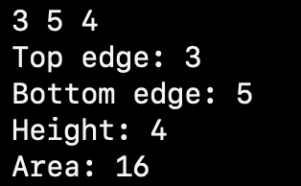

Input: cin Statement
console window:
console window :
1 // Example : area of the trapezoid
2 #include <bits/stdc++.h>
3 using namespace std;
4 int main(){
5 int a, b, c;
6 cin >> a >> b >> c;
7 cout << "Top edge: " << a << endl;
8 cout << "Bottom edge: " << b << endl;
9 cout << "Height: " << c << endl;
10 cout << “Area: ” << (a+b) * c/2 << endl;
11 return 0;
12 }
1 // Example : character triangle
2 #include <bits/stdc++.h>
3 using namespace std;
4 int main(){
5 char c;
6 cin >> c;
7 cout << c << endl;
8 cout << c<< c << endl;
9 cout << c << c << c << endl;
10 cout << c << c << c << c << endl;
11 return 0;
12 }

Slide 11
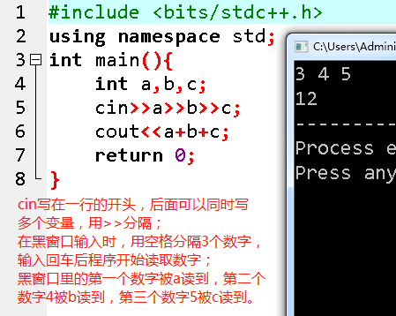
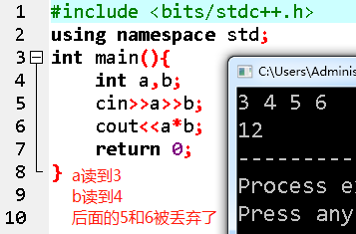
Input: cin Statement
cin statement is used to read data from the console window and assign it to variables
cin is at the beginning of a line, followed by >> , and then followed by the variable to be assigned.
If you want to read multiple values, use multiple >> to connect different variables
Key in SPACE or ENTER in the console window to separate multiple values
If the number of variables after cin is less than the number of values entered in the console window, cin takes the first several values and ignores the rest.
cin in the start of the line, followed by mulitple variables if necessary, separated by >>; when inputing in the console window, use spaces to separate 3 numbers. The program starts to get the numbers after ENTER. First number 3 is put in a, second number 4 in b, third number 5 in c.
A gets 3, b gets 4, remaining 5 and 6 are discarded

Slide 12
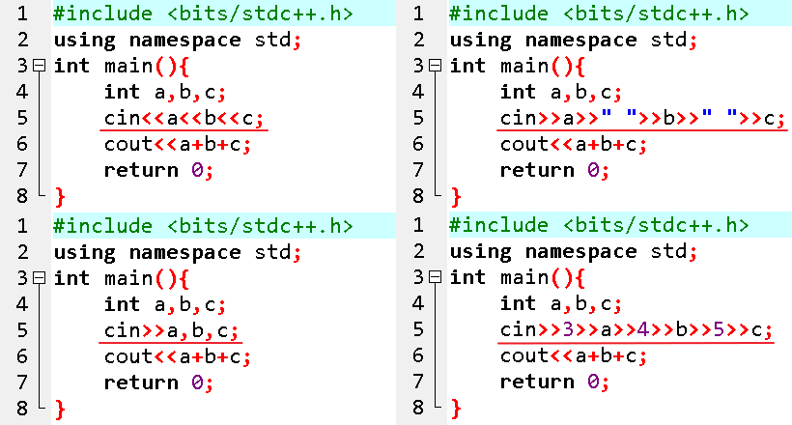
cin Common Mistakes
Correct:
cin>>a>>b>>c;

Slide 13
Variables
1 // Example: Definition and assignment
2 #include <bits/stdc++.h>
3 using namespace std;
4 int main(){
5 int a = 1, b, c, d; // assignment on definition
6 b = 2;
7 c = d = 3; // multiple assignments
8 cout << a+b+c*d; // output using current values of a,b,c
9 return 0;
10 }
A variable is equivalent to a room where data is placed
Put one data in one room
It must be defined before it can be used (unregistered rooms cannot be checked in)
The data type must be specified when defining a variable
You need to specify the room type, which determines how much data can be placed in the room.
Variable names
Call a specific room by room number
Composed of letters, numbers, and underscores
Cannot start numeral
Case sensitive
Cannot be a keyword
Multiple variables can be defined together, separated by commas
Assignment statements
The left side of the equal sign is the variable name, and the right side is the expression.
First evaluate the expression on the right, resulting in a value, and then place the value into the room represented by the variable on the left
Can be assigned consecutively
Accessing
The variable name in the expression represents the value of the variable
Expression with variable name: Read the current value of the variable and perform calculations
1 // Example: Definition and assignment
2 #include <bits/stdc++.h>
3 using namespace std;
4 int main(){
5 char a = '*', b;
6 b = '&';
7 cout << a << b; // output using current values of a,b,c
8 return 0;
9 }

Slide 14
Data Types: int and char
int
Integer type
Occupies 4 bytes
Value range: -2³¹ ~ 2³¹-1 , around -2.1 billion ~ 2.1 billion, -2×10⁹ ~2×10⁹, 2 followed by 9 zeros
char
Character type
Occupies 1 byte
Data range: -128~127
A character enclosed in single quotes
Each character in the ASCII table is represented by a number, which is the ASCII code (internal code)

Slide 15
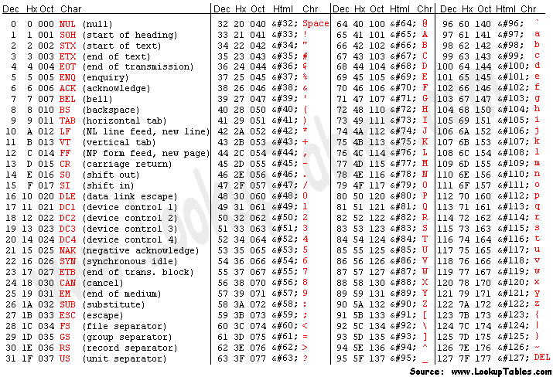
ASCII Code Table

Slide 16
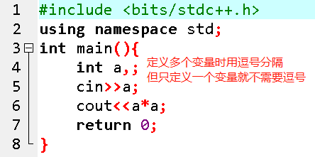
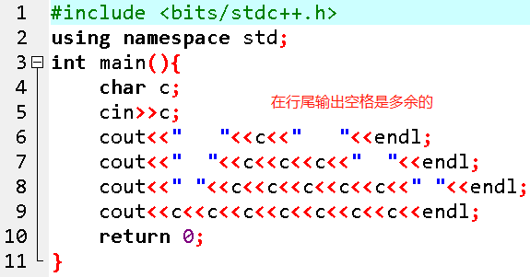
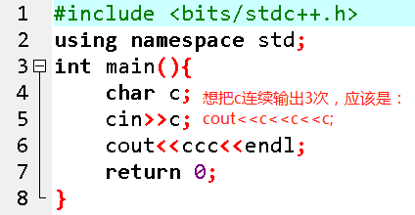
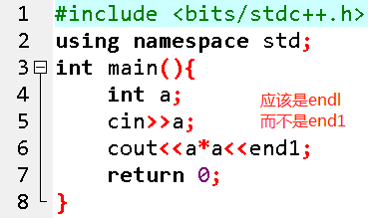
Common mistakes
Use commas to separate multiple variables when defining. Not needed when there’s only one variable.
It’s not necessary to output spaces at end of lines.
Want to output c 3 times? Use cout << c << c << c << endl;
Should be endl,
not end1.

Slide 17
thank you all
Note: Please turn off your microphone and camera
Mr. Gao’s Algorithm
Competition Training Camp

